Slide 1
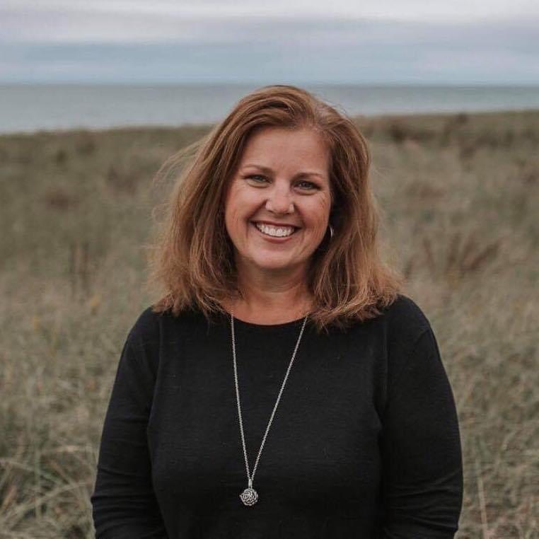
Using ISPROUT for ALL in the Early Childhood Classroom
Presentation by:
Kristin Parisi

Slide 2
Take Control of your Learning Experience
ON24 Learning Platform:
All windows are resizable and moveable
Use the Related Content box to access slides and resources
Submit your questions using the Q&A
PGP certificates are available for download
Use the toolbar to access other features and bring back minimized tools.

Slide 3
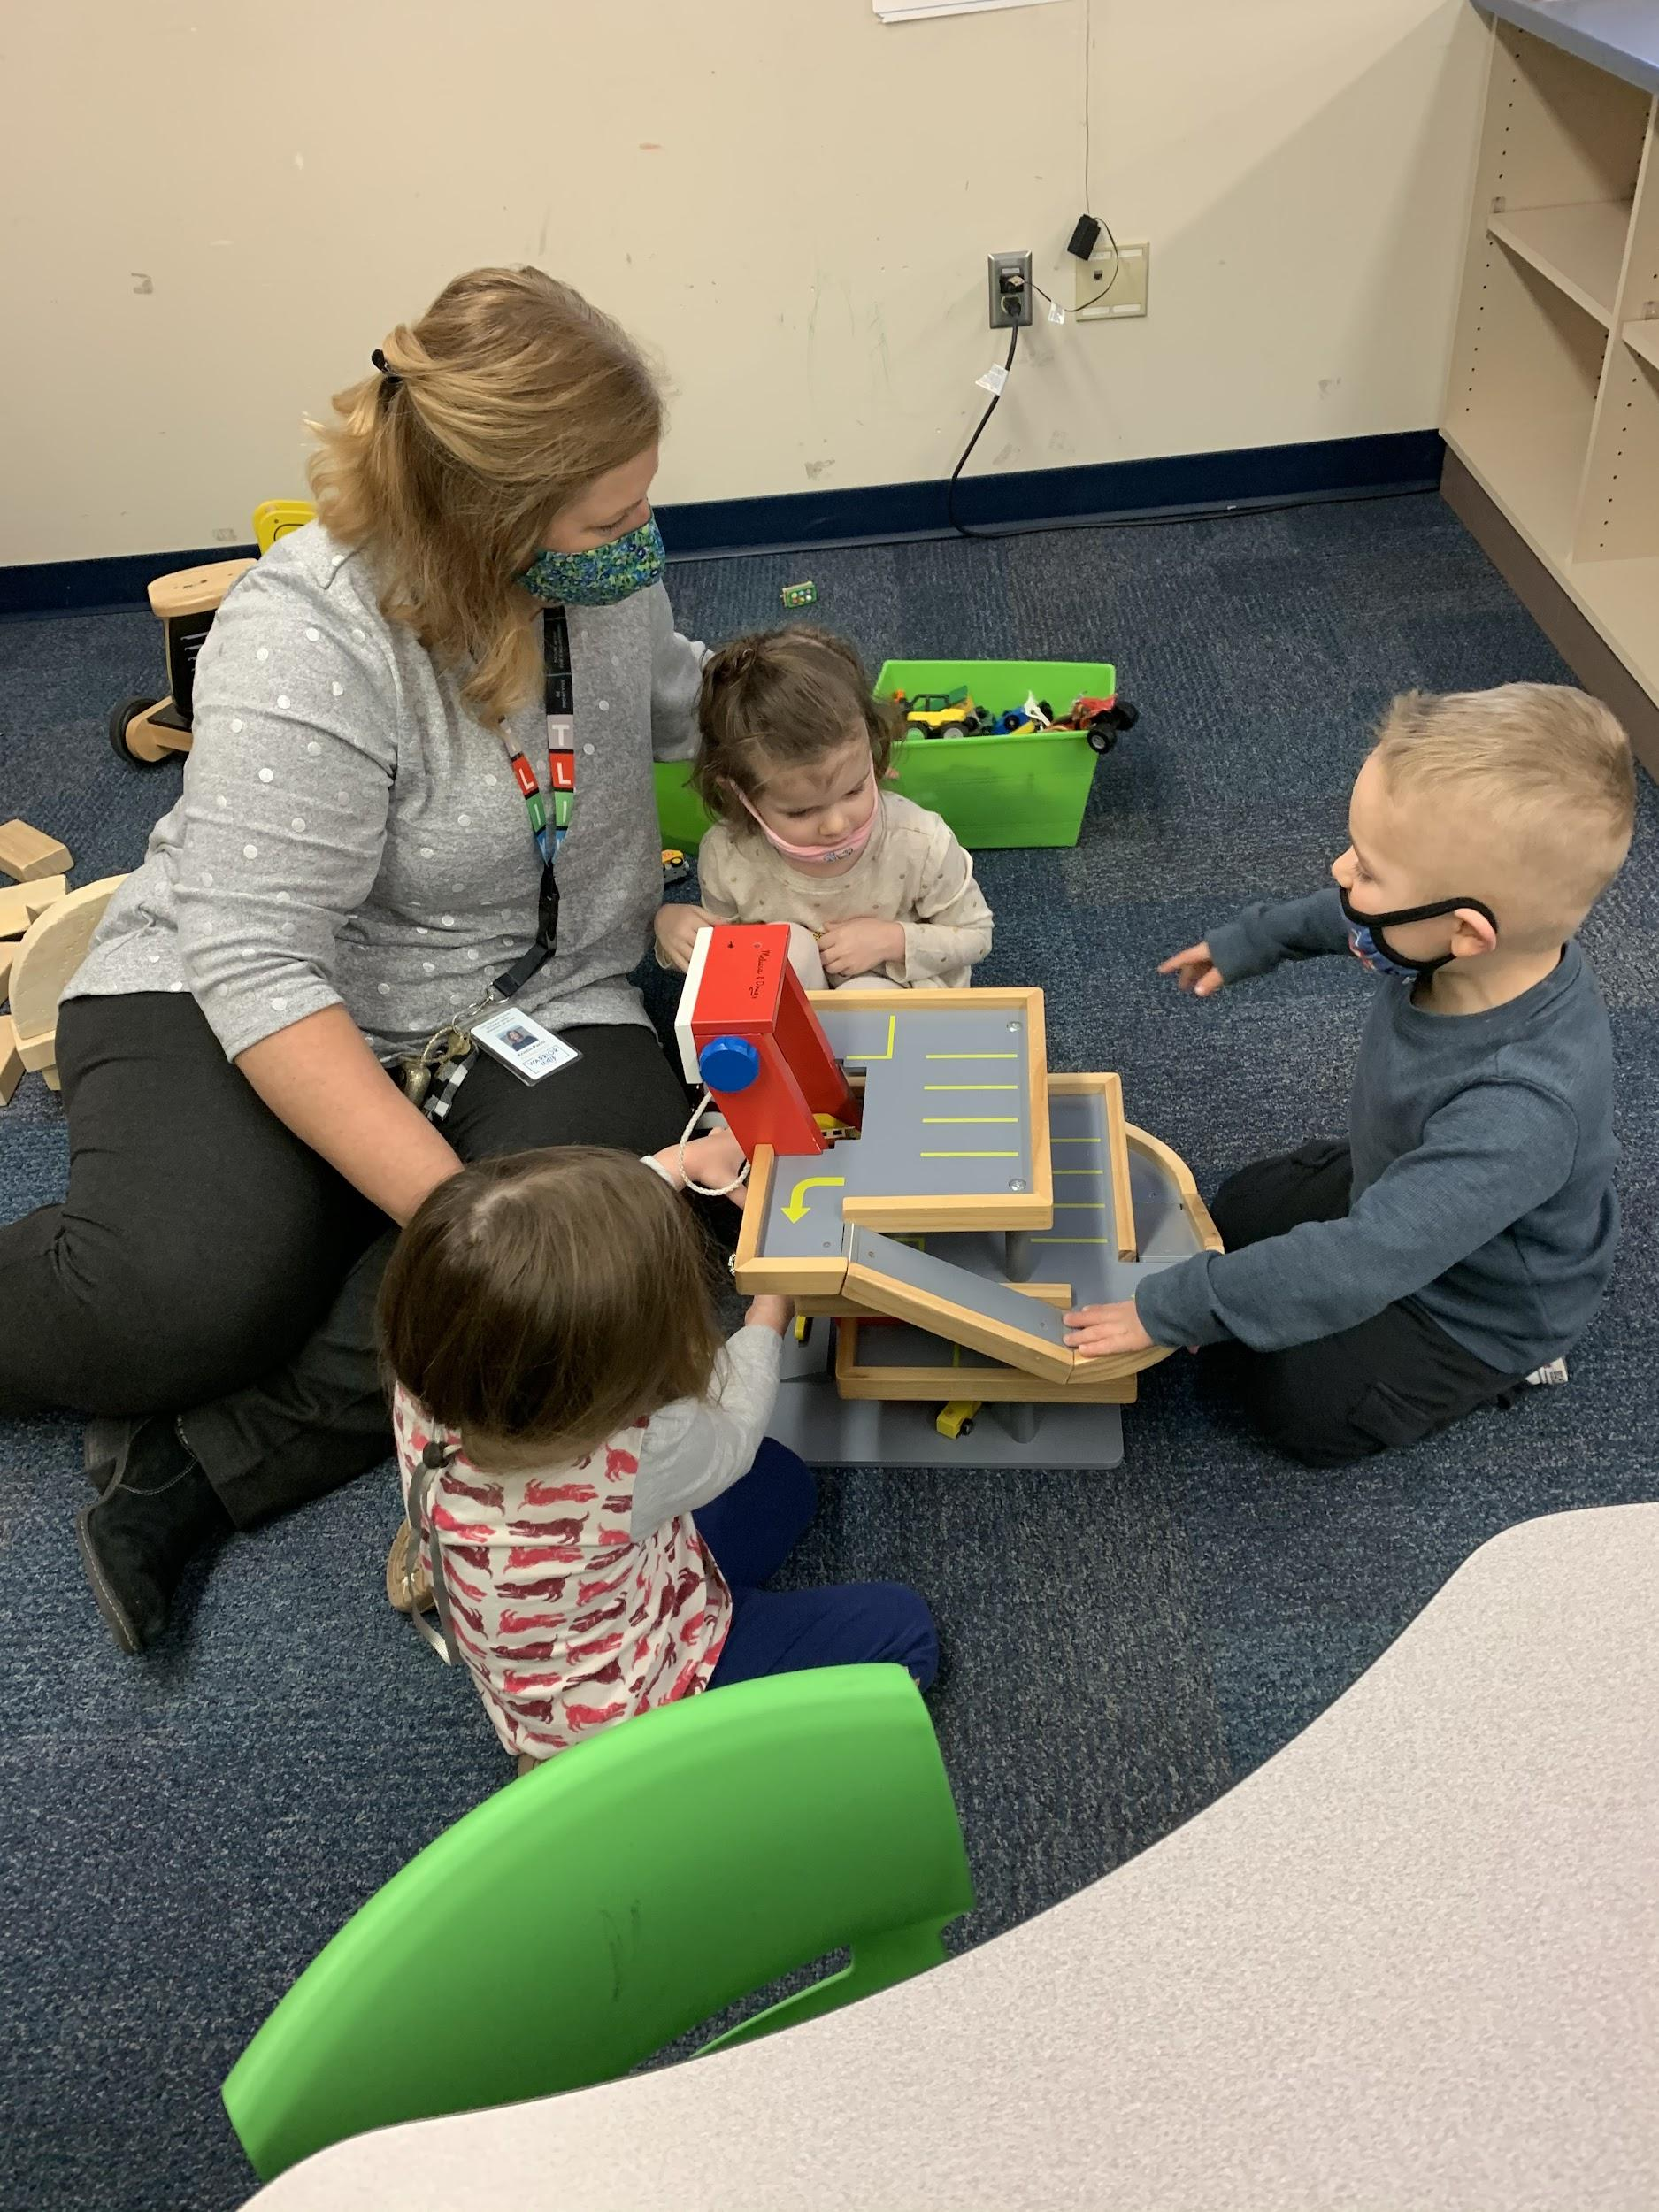
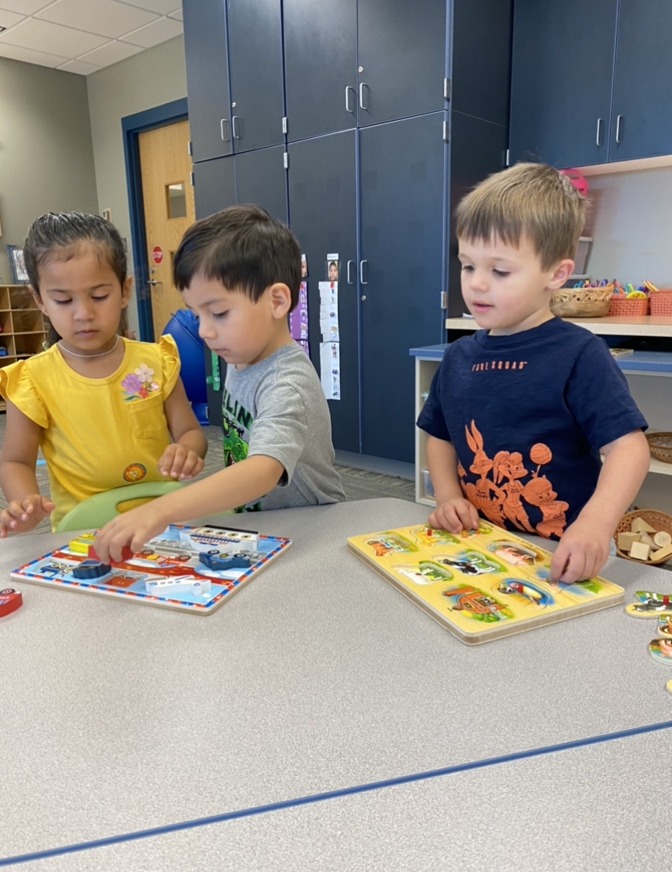
How and Why?
January 2021…How it began
PLCs
Data Discussion ~ What data piece do you use?

Slide 4
How DID WE Start?
Identify the need
Book Study
ISPROUT Training
SKBs / IEP Connection
Identify Essential SKBs

Slide 5
What We’ve Learned….
ISPROUT - DOE INFO
Data Manager
Teacher Training
Authentic Observation
Curriculum Link
CPCSC Observation Form
Parent Discussion / Print Report

Slide 6
Kristin Parisi
@kristinparisi
kparisi@cpcsc.k12.in.us

Slide 7
Thank you for attending!
Please complete the short feedback survey on the screen.
Don’t forget to download your PGP Certificate from the webcast toolbar.
Notes:
Make this the last slide in your presentation

